Slide 1
Coding Matrix Factorization
Massimo Quadrana
Maurizio Ferrari Dacrema

Slide 2
Outline
FunkSVD (rating prediction)
AsymmetricSVD (rating prediction)
IALS or WRMF (implicit feedback)

Slide 3

Matrix Factorization in RecSys
R
U
V^{T}
N items
K factors
N items
V_{J}
K factors
Musers
i
u_{i}
M users
$$≈$$
j

Slide 5
Matrix Factorization in RecSys
FunkSVD
From Simon Funk’s post:
http://sifter.org/~simon/journal/20061211.html

Slide 6
Matrix Factorization in RecSys
Optimization

Slide 7
Matrix Factorization in RecSys
Optimization
Least-squares (goodness of fit)
Regularization
(prevent overfitting)

Slide 8
Matrix Factorization in RecSys
Optimization
Least-squares (goodness of fit)
Regularization
(prevent overfitting)
WARNING: For simplicity I won’t include user and item biases in the models, but you can try with them at home

Slide 9
Gradient Descent Variants
Batch Gradient Descent
Calculate the gradients for the whole dataset to perform just one update
learning rate (or step size): controls speed of convergence (or divergence if too large)
Cons: Very slow, no online updates
Stochastic Gradient Descent
Perform a parameter update for each user-item tuple (i,j)
Pros: cheap updates, online update, same practical convergence of Batch-GD
Cons: high variance (fluctuations), local minima
Minibatch SGD (not-covered)
Update every minibatch of n training tuples
Pros over SGD: less variance → stable convergence, fast matrix-ops

Slide 10
Gradient Descent Variants
Batch Gradient Descent
Calculate the gradients for the whole dataset to perform just one update
learning rate (or step size): controls speed of convergence (or divergence if too large)
Cons: Very slow, no online updates
Stochastic Gradient Descent
Perform a parameter update for each user-item tuple (i,j)
Pros: cheap updates, online update, same practical convergence of Batch-GD
Cons: high variance (fluctuations), local minima
Minibatch SGD (not-covered)
Update every minibatch of n training tuples
Pros over SGD: less variance → stable convergence, fast matrix-ops

Slide 11
Matrix Factorization with SGD
Compute the partial derivatives

Slide 12
Matrix Factorization with SGD
Compute the partial derivatives
Random shuffle non-zero user-item pairs in R
For each sampled pair (i,j)

Slide 13
Matrix Factorization with SGD
Compute the partial derivatives
Random shuffle non-zero user-item pairs in R
For each sampled pair (i,j)
Complexity Time: O(nnz(R)) << O(MN) – Space: O((N+M)K)

Slide 14
MF-SGD tips and tricks
Tune the learning rate
Grid search with cross-validation
Reduce the learning rate over time with time decay
More sophisticated method (Adagrad, RmsProp,…)
Regularization factors play a big role
Tune them as well

Slide 15
Matrix Factorization in RecSys
AsymmetricSVD
Modified version of SVD++
SVD++ is FunkSVD with global effects

Slide 16

AsymmetricSVD
Basic idea: represent users latent factors as the weighted average of their rated item latent factors
R
R
X
Y^{T}
N items
N items
K factors
N items
y₂
y₅
y₇
K factors
N items
X_{j}
M users
i
i
u_{i}
$$≈$$
j
2
5
7

Slide 17
AsymmetricSVD
X and Y have the same shape but different meaning:
Y - how much a feature is important for an item
X - how much a feature is important for a user
R
R
X
Y^{T}
N items
N items
K factors
N items
y₂
y₅
y₇
K factors
N items
X_{j}
M users
i
i
u_{i}
$$≈$$
j
2
5
7

Slide 18
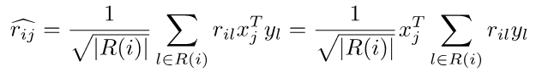
AsymmetricSVD
Prediction rule (again, biases are omitted):
R(i): rated by user i
Rated items

Slide 19
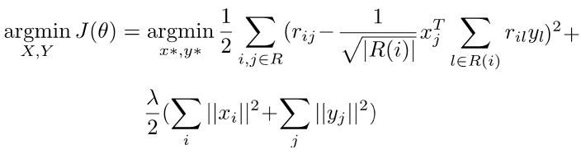
AsymmetricSVD
Prediction rule (again, biases are omitted):
R(i): rated by user i
Loss function

Slide 20
AsymmetricSVD
Pros:
Fewer parameters, usually N (items) << M (users)
Handle new users as soon as they start providing ratings
Cons:
Similar function but much slower training than simple FunkSVD, because of the summations

Slide 21
AsySVD-SGD updates
Partial derivatives
Update x_{j} and y_{l} similar to FunkSVD

Slide 22
Matrix Factorization in RecSys
IALS or WRMF
Matrix Factorization for implicit feedbacks

Slide 23
IALS or WRMF
Implicit Alternating Least Squares
Collaborative Filtering for Implicit Feedback Datasets (Hu et al, 2008)
Also called Weighted Regularized Matrix Factorization (WRMF)
Implicit feedback
Numerical values in explicit feedback express preference (1-totally dislike, 5-really like)
Numerical values in implicit feedback express confidence (e.g., how much time have I watched a movie?)
No negative feedback: missing as ‘not-interacted’

Slide 24
IALS
Basic idea
Split the numerical score r_{ij} into
preference score p_{ij} (p_{ij} = 1 iif r_{ij} > 0 else 0)
confidence score c_{ij}, for example
Linear scaling
Log scaling
The higher number of interactions, the higher the confidence

Slide 25
IALS
Basic idea
Matrix factorization over preference and confidence scores
Trained with Alternating Least Squares
Fixed Y, optimize for X
Fixed X, optimize for Y
Elementwise (Hadamard) product

Slide 26
Learning IALS
Alternating Least Squares
Fixed Y, optimize for X
Equivalent to
where C^{i} NxN diagonal matrix with C^{i}_{jj} = c_{ij}
and p(i) is the vector of preferences of i

Slide 27
Learning IALS
Alternating Least Squares
Fixed Y, optimize for X
Partial derivative
Update Rule

Slide 28
Learning IALS
Update rule - a trick
Back to ALS
Fixed X, optimize for Y
Implementation
Slow iterative code with numpy (uses _lsq_solver)
Fast numpy only (uses _lsq_solver_fast)
Faster parallelized version at this link: https://github.com/benfred/implicit
Independent from i
→ Precompute
Depends only on the non-zeros in p(i)!!!
(if one of the previous scaling functions is used)

